Slide 1
SARCASM DETECTION
Vaibhav Chandra 190001065

Slide 2
PROBLEM STATEMENT
This project aims to develop a complete deep learning pipeline for the task of sarcasm detection.
Sarcasm detection basically involves classifying a given corpus of text as either sarcastic or non-sarcastic.
The corpus of text maybe a tweet, news headline, facebook comments or other sources.
Various pre-trained Deep learning architectures have been assessed for this task.

Slide 3
INTRODUCTION
The field of Natural Language Processing (NLP) has been successfully used in a wide range of tasks such as classification, text summarization, translation, part of speech tagging and others.
With the recent advancement in the architectures used in NLP, researchers have been trying to tackle many real life scenarios.
Sarcasm Detection is one such problem that has grabbed the attention of researchers.
Many new architectures have been developed for solving this task of sarcasm detection. Most of these architectures revolve around the Transformer⁽¹⁾ model.
We provide a comprehensive comparison of different transformer models that are well suited for this classification problem.
(1): Vaswani, Ashish, et al. "Attention is all you need." Advances in neural information processing systems 30 (2017).

Slide 4
TRANSFORMERS
Transformer was proposed by a group of Google Researchers.
It uses Multi-head Self-Attention mechanism to capture long range dependencies in the text.
It is due to this attention mechanism that the transformer model has been successfully proposed in almost every domain that stems from NLP.
Transformers improve upon its traditional counterpart LSTM by parallelisation of inputs.

Slide 5
DEEP LEARNING MODELS
With the advent of Transformer, many deep learning architectures have been proposed that can be used for wide variety of downstream tasks.
BERT is one such revolutionary model which stands for Bidirectional Encoder Representations from Transformers.
It is designed to pre-train deep bidirectional representations from unlabeled text by jointly conditioning on both left and right context in all layers.
It uses “masked language model” (MLM) pre-training that enables it to achieve state-of-the-art metrics for GLUE, MNLI, SQuAD.
We compare three models namely RoBERTa,DistilBERT and alBERT that are built upon the BERT model on our problem of sarcasm detection.

Slide 6
RoBERTa
BERT was computationally expensive model containing millions of hyperparameters and was highly undertrained.
RoBERTa was , hence, developed to cater the shortcomings of the BERT model.
Modifications on top of BERT include:
Training the model longer, with bigger batches,over more data
Removing the next sentence prediction objective
Training on longer sequences
Dynamically changing the masking pattern applied to the training data.

Slide 7
DistilBERT
BERT model was very big in size in terms of number of hyperparameters. DistilBERT aimed at reducing this size.
DistilBERT was 40% smaller in size and 60% faster than BERT while retaining the language learning capabilities.
The novelty introduced in DistilBERT included a triple loss combining :
language modeling
distillation
cosine-distance losses

Slide 8
alBERT
alBERT was also built upon BERT aiming to reduce memory consumption and increasing training speed.
Since alBERT and RoBERTa try to overcome the same problem of high memory consumption and large model size of BERT, they have a number of similarities.
alBERT establishes new state-of-the-art results on the GLUE, RACE, and SQuAD benchmarks while having fewer parameters compared to BERT-large.

Slide 9
DATASET
The dataset that we have used to train the discussed models consists a number of news headlines
Each headline has a corresponding labels indicating whether it is a sarcastic or a non-sarcastic headline
The dataset has about ~27000 data points.
The same can be accessessed here:- dataset

Slide 10
MODELS COMPARISON
We compare the three models discussed previously namely RoBERTa, DistilBERT and alBERT for the sarcasm detection task.
 | Training Accuracy | Validation Accuracy
RoBERTa | 97.47 | 90.49
DistilBERT | 98.73 | 91.14
alBERT | 96.66 | 88.24

Slide 11
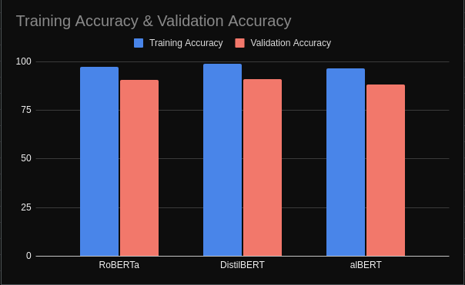
MODELS COMPARISON
The table presented can also be visualized as follows:

Slide 12
CONCLUSION
We discussed the problem of sarcasm detection which has emerged has a new research topic in the field of NLP.
We also discussed transformer-based deep learning models that can be used to solve this task.
The metrics obtained shows the effectiveness of these models for this sarcasm detection task.
We aim to test few more models and also try to build a novel model in this direction.

